Slide 1

AutoGen Studio Practical Example
Apoorv Vishnoi
Head of Training, Analytics Vidhya
Notes:
Hi and welcome back! In this video, we will create a sequential chat agentic system with a tool in AutoGen studio. For simplicity, we will be using the same problem statement that we used in Module 2. I will repeat the problem statement again. YOu can pause the video and read the problem statement.

Slide 2
Introduction to AutoGen Studio
Apoorv Vishnoi
Head of Training, Analytics Vidhya
Notes:
Hi and welcome back! In this video, we will create a sequential chat agentic system with a tool in AutoGen studio. For simplicity, we will be using the same problem statement that we used in Module 2. I will repeat the problem statement again. YOu can pause the video and read the problem statement.

Slide 3
Installing AutoGen
Role: You are the Learning & Development (L&D) Head.
Goal: Create a system to generate a newsletter for employees.
Focus: Latest advancements in AI Agents and Generative AI.
Resource: Use AV’s blogs for professional insights and updates.
System: Develop an automated agentic system to:
  Query Analytics Vidhya for recent articles and news.
  Curate relevant content on AI Agents and Generative AI.
  Compile the curated content into a newsletter email.
Outcome: Ensure employees stay informed and aligned with industry advancements, promoting continuous learning.
Notes:
The RealtimeAgent is designed to handle real-time conversational AI tasks by connecting with live APIs, databases, or web services. This feature allows agents to manage time-sensitive queries, ensuring prompt responses and relevance in rapidly changing scenarios. Whether it's real-time voice interaction or dynamic text inputs, RealtimeAgent makes your agentic systems smarter and more responsive.

Slide 4
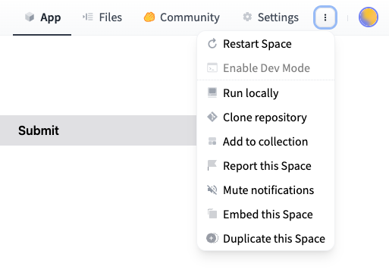
Notes:
First is Image Captioning. It describing what’s happening in a photo.

